Slide 1
Postgraduate Overview of Software Engineering (POSE) Weekly Q&A Briefing
This session will commence shortly

Slide 2
Recap: What is this unit all about ?
Aim of this unit is to introduce processes and practices of
“Software Engineering”
Up to this point, you have been approaching development in an fairly ad-hoc and “organic” manner
Our aim on this unit is to introduce something more systematic and repeatable: something that is likely to succeed EVERY TIME
(Also something that would be recognisable by industry !)

Slide 3
Recap: Topics Covered (so far)
Overview of Software Processes (including “Agile Development”)
System Analysis: Identifying and defining “the problem”
Design: Devising a high-level “solution” to the defined problem
Implementation: Covered in other units !
Testing: Verifying the implementation operates “correctly”
Continuous Integration: Keeping system operational throughout dev.
Failure Analysis: Identifying faults and causes (based on Kegworth)
Professional Behaviours: Considering practices (based on Kegworth)

Slide 4
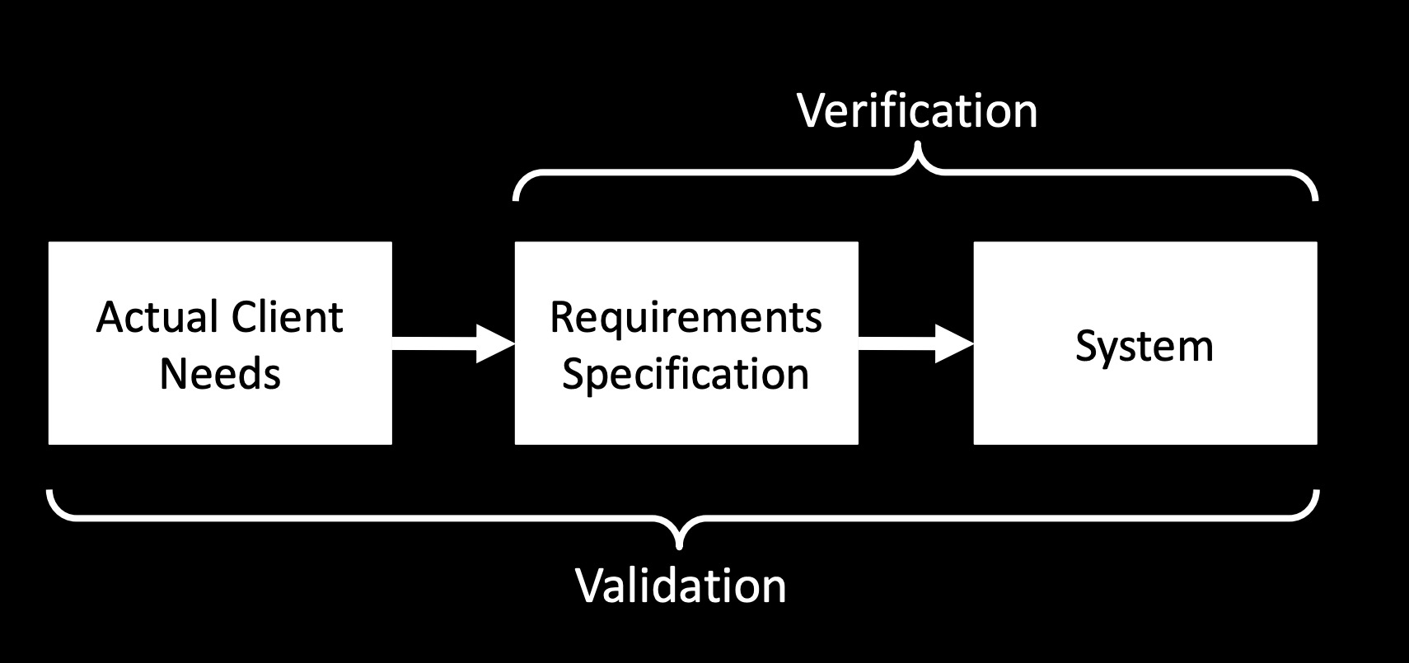
Recap: Verification & Validation

Slide 5
What have we yet to consider ?
We’ve spent a lot of time considering “unit testing”
Here the test cases are the system specification
Which makes it very convenient to verify the system !
But how do we know that those test cases are “good”
Identifying test cases is HARD (you might have noticed !)
Need to be complete, comprehensive, correct, consistent
At some point we must go back to the client for VALIDATION

Slide 6
Once last time…

Slide 7
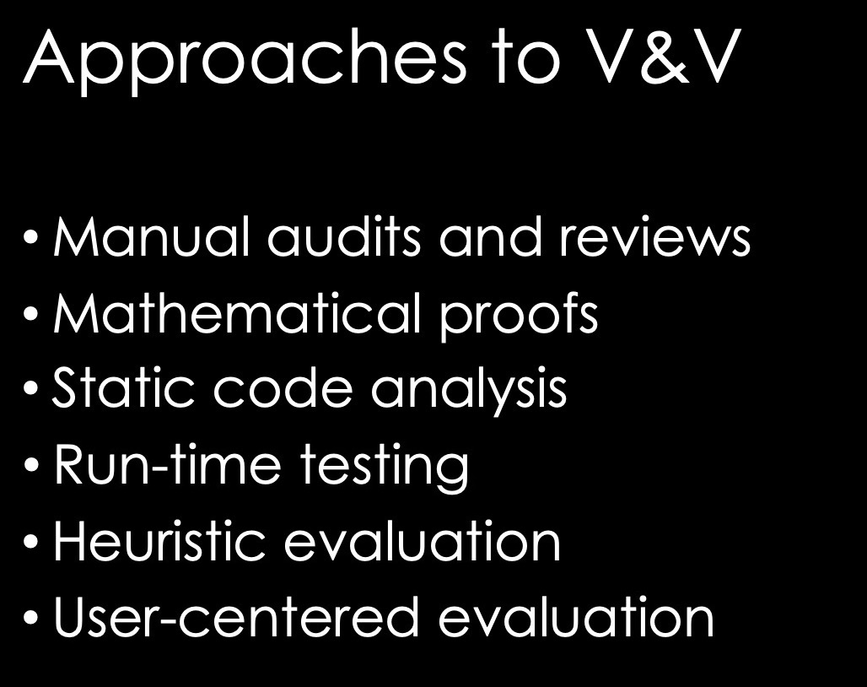
Undertaken informally by TAs in labs
Will be part of Java manual marking
Not really part of this programme :o)
Code quality analysis tools !
Test-Driven Development !!!
Next segment of this unit…

Slide 8
Assessment
Current exercise (Kegworth) is worth 50% of the unit
Remaining 50% will be on the project proposal
Brief will be released before easter
The proposal will require a detailed section on user-testing.
This gives the chance of exploring up to 5 different methods of user testing if working in a group.

Slide 9
HCI Evaluation
The lectures this week and next week are a two part overview of HCI evaluation methods:
Part 1
Methods of gathering data:
Questionnaires / Observations / Interviews / Focus groups / Ethnography
Part 2
Making sense of your data (qualitative / quantitative)
Evaluating a working prototype.

Slide 10

What next?
The two videos will give an introduction to HCI evaluation methods.
Some tasks around evaluation in the Tuesday sessions.
Project proposal will require a section planning evaluation methods.
This will require reading beyond the introduction videos. Get a pdf of this book from the library now as a starting point! (no workbooks for this section)
Solid evaluation methods used throughout the development of your project over summer will lead to a good grade!
Notes:
Developing a working system is only half of the Design should not only fit the

Slide 11
What next?
Designing a working system is only half of the picture.
Evaluation has two major roles in your project:
Ensuring your design actually fits the needs/desires of the usergroup/client/stakeholders
Will provide important evidence in your final report that it actually meets those needs!
Tuesday sessions:
Making contact with your client
Contracts (for groups)
Evaluation planning
Tech overviews and tech planning.
Project proposal brief

